Slide 1
The effect of 2025 staffing cuts on National Weather Service (NWS) warning performance
A before/after analysis of detection, false alarms, and lead time across nine tests
Craig Rudman
MSDS692 Data Science Practicum I
Anderson College of Business and Computing
Regis University, Denver, CO, USA
crudman@regis.edu

Slide 2
The question and why it matters
Staffing reductions at NWS began February 27, 2025.¹
Did warning performance change afterward?
This study tests that question quantitatively.
The finding is an observational comparison, not a controlled experiment. It establishes whether a metric changed, but not why.
Scope
10 study years (2016 to 2025)
116 Weather Forecast Offices (WFO) out of 121, clipped to the continental United States
Data²
376,963 local storm reports (LSRs)
260,537 warnings
3 phenomena:
Severe thunderstorms (SV)
Flash Floods (FF)
Tornadoes (TO)
Dance, S. (2025, February 27). Mass firings hit critical National Weather Service and NOAA offices. The Washington Post. https://www.washingtonpost.com/climate-environment/2025/02/27/noaa-nws-mass-firings-trump-administration/
Iowa Environmental Mesonet Cow (NWS Storm Based Warning Verification), Iowa State University. https://mesonet.agron.iastate.edu/cow/
Notes:
This study examines whether warning performance changed following widely reported staffing reductions at the National Oceanic and Atmospheric Administration (NOAA) and the National Weather Service (NWS) beginning in February 2025. Using publicly available verification data from the Iowa Environmental Mesonet (IEM) Cow application, we compare probability of detection (POD), false alarm ratio (FAR), and lead time in advance (LTA) across 116 of the the agency's 122 Weather Forecast Offices (WFOs) between a baseline period of 2016 to 2024 and the post-treatment year of 2025. A statistically significant change in performance would be consistent with the hypothesis that staffing reductions affected warning quality; the absence of such degradation would provide empirical grounds for reassurance. The study cannot establish causality, but contributes a documented, reproducible methodology for evaluating NWS warning performance over time using publicly available data.

Slide 3
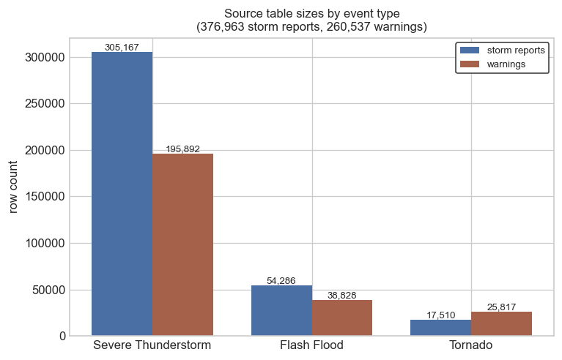
How warning performance is measured¹
Probability of Detection (POD)
Of events that occurred, what share were warned?
False Alarm Ratio (FAR)
Of warnings issued, what share did not verify?
Lead time average (LTA)
Minutes between warning issuance and event onset; conditional on detection.
Reports without warnings are undetected; warnings without reports are false alarms
1. Brooks, H. E., & Correia, J., Jr. (2018). Long-term performance metrics for National Weather Service tornado warnings. Weather and Forecasting, 33(6), 1601–1614. https://doi.org/10.1175/WAF-D-18-0120.1

Slide 4
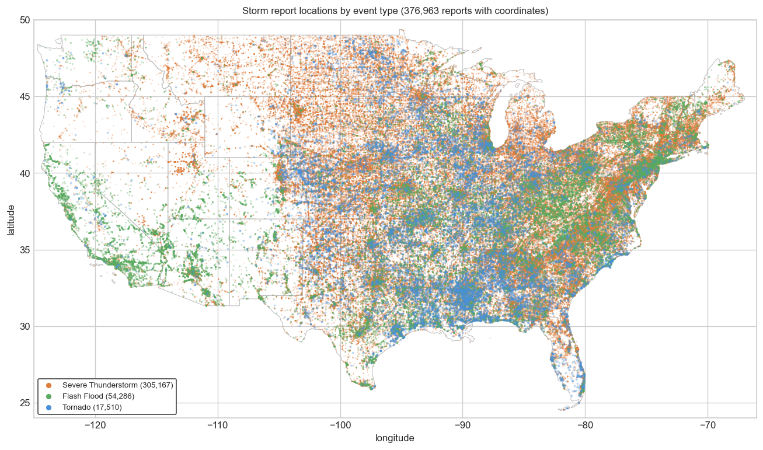
Geographic distribution of storm reports (2016-2025)
Events distribute and cluster in differing patterns by phenomenon.
Reports cover the contiguous United States but not evenly: severe-storm and tornado reports cluster through the plains and southeast, flash-flood reports follow flood-prone terrain more broadly. The footprint is national, but the density is regional.

Slide 5
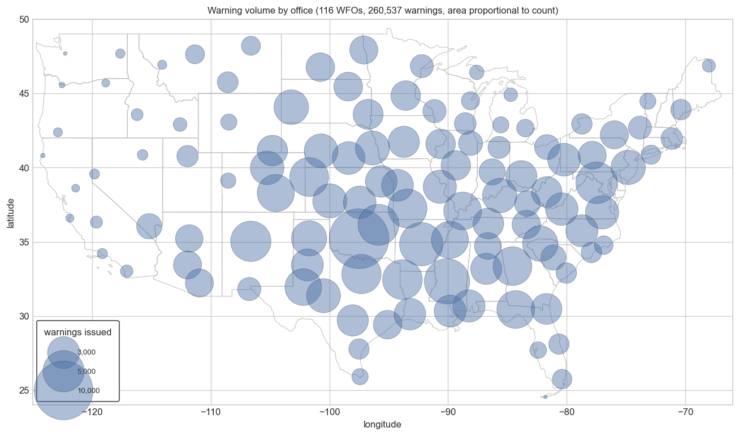
Warnings per WFO (2016 – 2025)
Warnings are distributed across WFOs unevenly.
Warning volume is uneven across the office network. The largest markers cluster through the plains and the southeast, where severe-storm and tornado activity concentrates, while western and northeastern offices issue far fewer warnings.

Slide 6
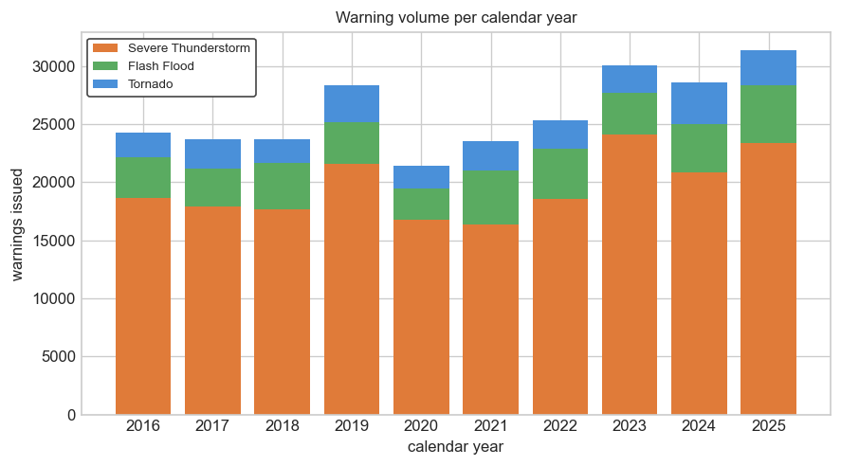
Warnings per year (2016 – 2025)
The volume of warnings varies from year-to-year overall and by phenomenon.
Every study year carries data for all three types, with no year missing or collapsing. Total volume fluctuates year to year as weather does.

Slide 7
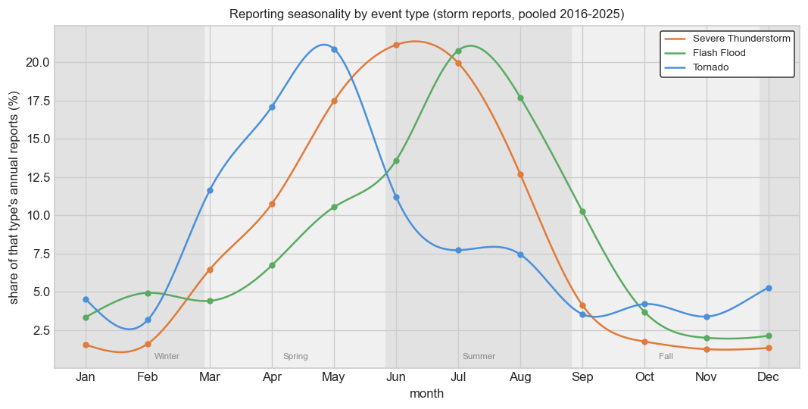
Seasonality of storm reports (2016-2025)
Weather patterns are seasonal.
Each type has a distinct seasonal signature. The shaded bands mark four engineered seasons; note they break on the 27th of February, May, August, and November (anchored to the treatment anniversary), not on the canonical calendar dates

Slide 8
After accounting for season and the 2016 to 2024 trend, where does 2025 land?
outcome ~ C(season_cat)+ study_year + is_year10
The model
After accounting for normal seasonal swings and the baseline year-to-year trend, did year 10 land off that expected line, and by how much?
Why not a flat baseline mean?
If a metric drifts across 2016 to 2024, the expectation for 2025 is not the baseline average, it is where the season-adjusted trend would land.
Metric | SV | TO | FF
POD | OR 1.01 p=0.37 | OR 1.09 p=0.17 | OR 1.04 p=0.26
FAR | OR 1.15 p≈1e-17 | OR 1.03 p=0.56 | OR 0.87 p≈3e-4
LTA | -0.2 min p=0.10 | -0.6 min p=0.15 | -13.0 min p=2e-13
Bold marks statistically significant results that carry forward to placebo and FDR checks.

Slide 9
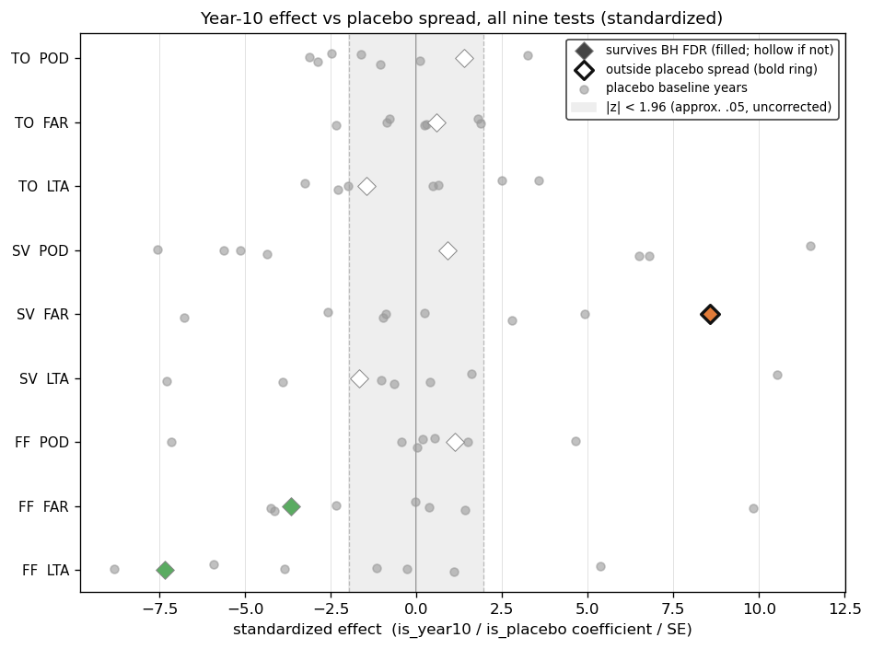
Two tests to guard against false positives
Placebo test
Drop year 10. For each interior baseline year, refit with the indicator pointing at that year instead of 2025. Collect the placebo coefficients into a spread.
Benjamini-Hochberg FDR Correction
Fit the data to the model with 2025 as the treatment. Rank the p-values from each and accept each one whose value falls below its rank’s proportional share of the false-discovery budget
(i.e. α = 0.05).
Only severe-storm FAR sits clearly right of its placebo cloud and the ±1.96 band; the other eight fall inside their grey placebo spreads.
Notes:
The per-metric placebo figures each live on their own native scale (log-odds for detection and false alarms, minutes for lead time), so they cannot be compared side by side. This figure puts all nine tests on one axis by standardizing every effect to its Wald statistic (coefficient divided by standard error), which is unitless and shares the same plus or minus 1.96 significance reference across the logistic and ordinary least squares (OLS) fits. Each row is one event-type by metric cell: grey points are the placebo baseline years, the colored diamond is the real year-10 effect. A diamond outside both its grey placebo cloud and the shaded band is the distinctive, credible case; one inside the cloud is flagged about as readily as an innocent baseline year. The nine placebo tables are recomputed here from the same event-type subsets used above so the cell is self-contained.

Slide 10
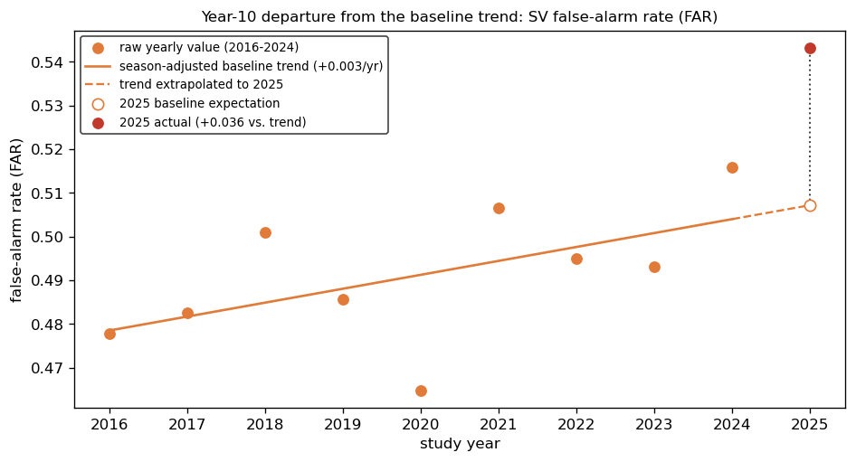
Severe-storm false alarms: a real departure
2025 had more false alarms for severe thunderstorms than can be explained by normal year-to-year variation.
false-alarm odds up ~15%
p < 0.001, survives FDR
outside placebo spread
The year-10 false-alarm rate (0.543) for severe thunderstorms rises above the extrapolated baseline trend (0.507), a gap of +0.036, meaning more false alarms than the trend predicts. Study year is offset from calendar (Feb 27 to Feb 26).

Slide 11
What this does not show
No causal attribution to staffing.
No reliable per-office staffing or vacancy data was available. Year-10 changes cannot be tied to staffing under this design.
LSRs are imperfect ground truth.
Changes in reporting effort can mimic changes in detection.
Office-level heterogeneity is descriptive, not tested.
Per-office year-10 effects show meaningful spread for every metric; no valid joint test at this design. A where-to-look signal, not a claim.

Slide 12
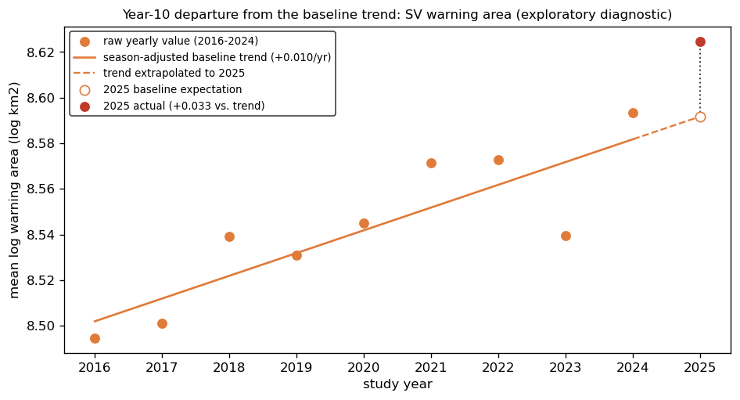
Did SV false alarms come with larger warnings?
A diagnostic on the false-alarm finding, not a tenth test
If 2025 had more severe-storm false alarms, were the warnings also drawn larger? Larger polygons are more precautionary and sweep up more non-events.
Exploratory; excluded from the nine FDR-corrected tests
Severe-storm warning area departs about +4% above the season-adjusted baseline trend in 2025, the same direction as the year-10 rise in false alarms. Bigger, more precautionary polygons would be consistent with more warnings that did not verify. Descriptive, not causal.

Slide 13
Conclusions
Across nine tests, no broad evidence that NWS warning performance changed in 2025.
Flash-flood FAR and lead time were statistically significant and survived FDR but failed the placebo check. Baseline years produced effects just as large, so they are not treated as findings.
One cautious finding: SV FAR odds up about 15%, with POD and LTA unchanged. One potential explanation is a procedural change to larger warning areas. This deserves a deeper dive.
WFO staffing data would potentially enable comparing offices that lost staff against those that didn’t, turning this association into a causal, difference-in-differences test.
Questions

